Slide 1


Module 6: Credit Reports and Scores
Credit and Credit Scores
Katherine Marin
M.Ed., MHFA
Extension Agent
Miami-Dade County
1st time-homebuyer workshop
Credit and Credit Scores
September 2018

Slide 2
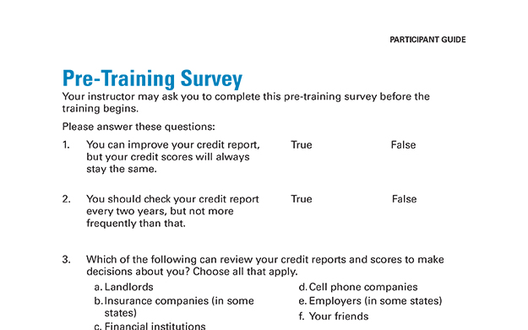
Pre-Training Survey

Slide 3
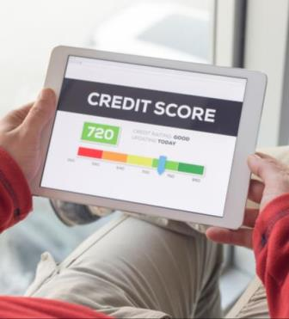
What Is a Credit Score?
A number based on information in credit reports
Predicts payment of bills and debts as agreed
People with higher credit scores likely to present lower risk to creditors

Slide 4
Who Uses Credit Reports and Scores?
Financial institutions
Some landlords
Utility companies
Some cell phone companies
Insurance companies (in some states)
Employers (in some states)
Some state agencies or affiliated organizations

Slide 5



Nationwide Credit Reporting Agencies
Equifax
Experian
TransUnion

Slide 6
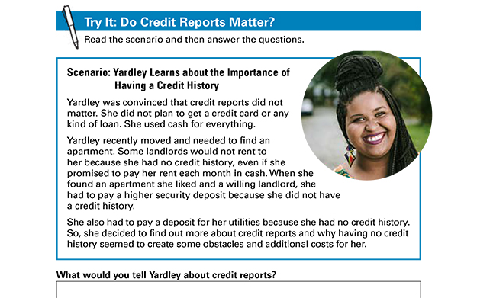

Slide 7
Risk-Based Pricing
Credit reports and scores may be used as one factor in risk-based pricing
Lenders set interest rates and other terms based on estimated risks
  Must tell you if they used your credit reports or credit scores to deny your application or offer you less favorable terms
    Adverse action notices
    Risk-based pricing notices

Slide 8
Having No Credit Reports or Scores
“Credit invisible”
May result in having a harder time:
  Getting credit or a loan
  Renting an apartment
  Getting a favorable cell phone plan
  Obtaining some jobs
  Turning on utilities without paying a large deposit

Slide 9
Key Takeaway
Your credit history can affect your access to credit, loans, jobs, housing, insurance, and other important services. Understanding your rights helps you know how to protect your credit history.

Slide 10
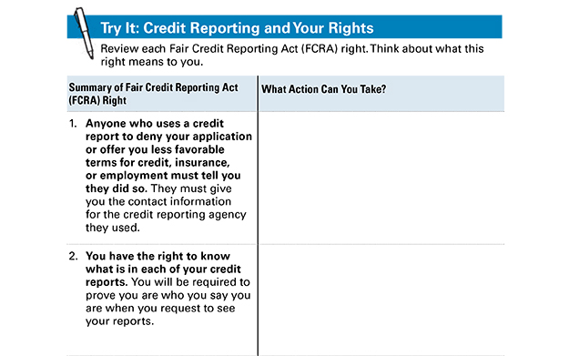
Try It: Credit Reporting and Your Rights

Slide 11
FCRA
The Fair Credit Reporting Act (FCRA) is a federal law that helps to ensure the accuracy, fairness and privacy of the information in consumer credit bureau files. The law regulates the way credit reporting agencies can collect, access, use and share the data they collect in your consumer reports.

Slide 12
Opting Out
You can opt out of receiving prescreened offers of credit or insurance
  For five years or permanently
You may still get offers based on lists from other sources
If you opt out, you can opt back in
But you can’t opt out of having a credit report
https://www.optoutprescreen.com

Slide 13
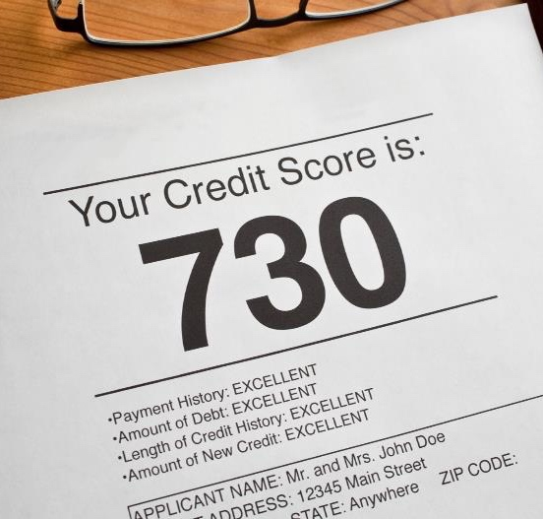
Section 2: Credit Scores
Section 2
Credit
Scores

Slide 14
What is a Good Credit Score?
Exceptional | 800 – 850
Very Good | 740 – 799
Good | 670 – 739
Fair | 580 – 669
Poor | 300 – 579
Note: this is an example, based on FICO®

Slide 15
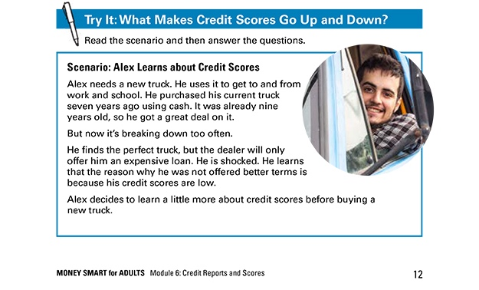
Try It: What Makes Credit Scores Go Up and Down?

Slide 16
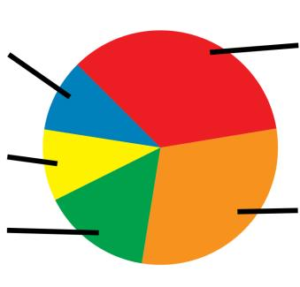
Five Factors in General FICO® Model
Payment History – 35%
New Credit – 10%
Credit Mix – 10%
Length of
Credit History – 15%
Amounts Owed – 30%

Slide 17
Section 2: Key Takeaway
You can take steps to improve and manage your credit scores. This includes paying your bills on time
and as agreed.

Slide 18
Order Your Credit Scores
May not be the ones that are used
If turned down for credit, you have the right to see the exact score used
Make sure your credit scores accurately reflect information in your credit reports
  Get and review your credit reports and dispute errors

Slide 19
Key Takeaway
Get and review your credit reports at least once every 12 months to make sure the information
is accurate.

Slide 20
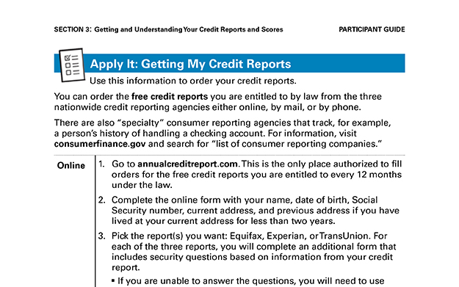
Apply It: Getting My Credit Reports

Slide 21
Right to Free Credit Reports
One free credit report every 12 months from each nationwide credit reporting agency
  Equifax, Experian, and TransUnion
Go to Annualcreditreport.com
  Official website to fill orders for these free credit reports

Slide 22
Watch Out for Imposters
Others that advertise free credit reports, credit scores, or credit monitoring are not part of the legally mandated free annual credit report program
Often, “free” services convert to ones you have to pay for after the trial period
Go directly to Annualcreditreport.com

Slide 23

Right to Additional Free Credit Reports
Receive public assistance
Unemployed and looking for a job
Victim of identity theft or financial fraud
State law provides for a free credit report
Denied credit, service, an apartment, or employment

Slide 24
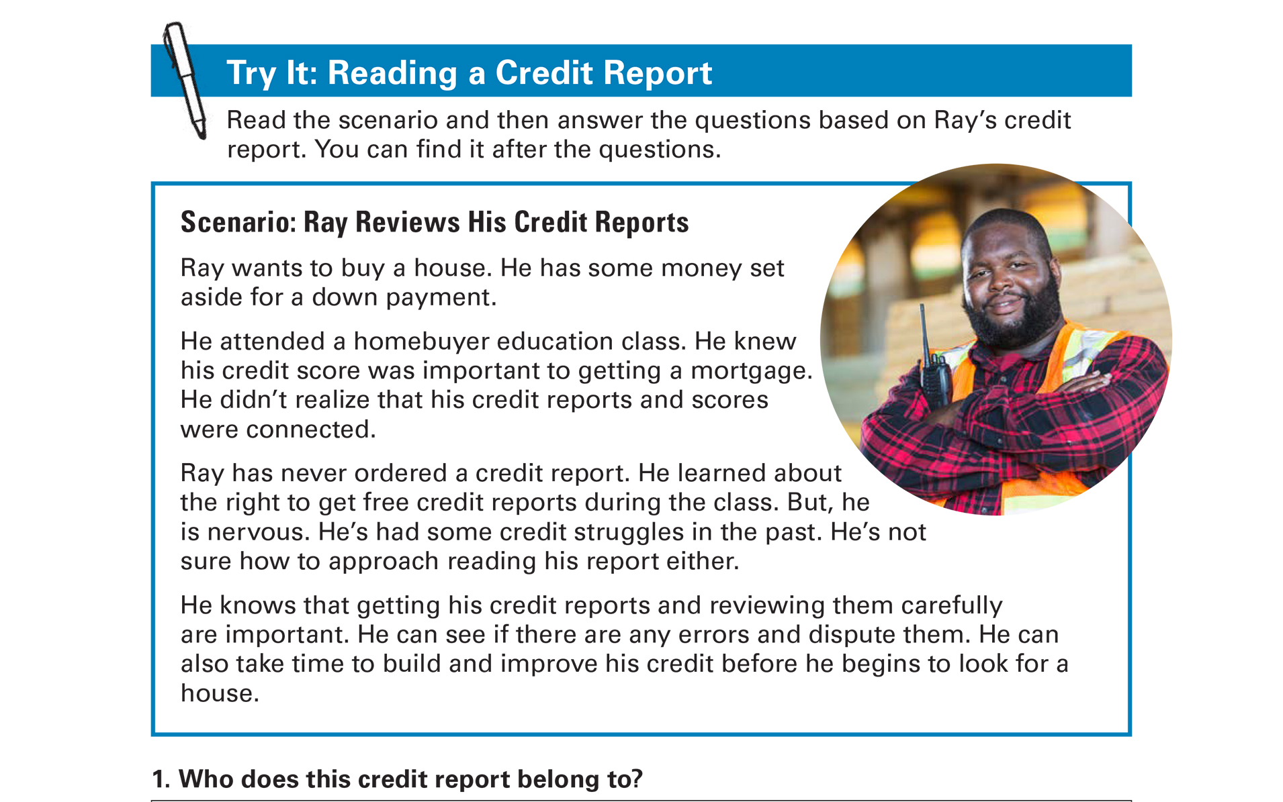
Try It: Why Read/Understand our Credit Report?

Slide 25

Section 4: Disputing Errors in Your Credit Reports
Section 3
Disputing Errors in
Your Credit Reports

Slide 26

Errors on Your Credit Reports
Identity errors
Incorrect reporting of account status
Data management errors
Balance errors
Outdated information

Slide 27
Section 3: Key Takeaway
If you find errors on your credit reports, file a dispute right away. Be sure to keep records and follow up.

Slide 28
Medical Debt and Credit Reports
Medical debt generally not on credit reports until unpaid for at least 180 days
Provides time to:
  Resolve billing disputes
  Make payments
  Make payment arrangements

Slide 29

Time Limits on Negative Information
Generally can only be reported on credit reports for seven years
Some bankruptcies are an exception

Slide 30

How to Dispute Errors on Your
Credit Reports
Option 1: Online
Option 2: By mail

Slide 31
What to Include in Dispute Letters
Your complete name and address
Clear description of each item you are disputing and reason for each dispute
A request for correction or removal

Slide 32
Also Include Supporting Information
Send copies – not originals
Receipts
Credit card or account statement
Image of a check
Screenshot of online transaction or automatic bill payment

Slide 33
After You File a Dispute
Credit reporting agency will send you a letter
Incorrect information cannot be put back
  Check to make sure
You can request notices of corrections to be sent to individuals or businesses that received your report

Slide 34

Section 5: Build, Repair, and Maintain a Productive Credit History
Section 4
Build, Repair, and Maintain a Productive Credit History

Slide 35
What is a Productive Credit History?

Slide 36
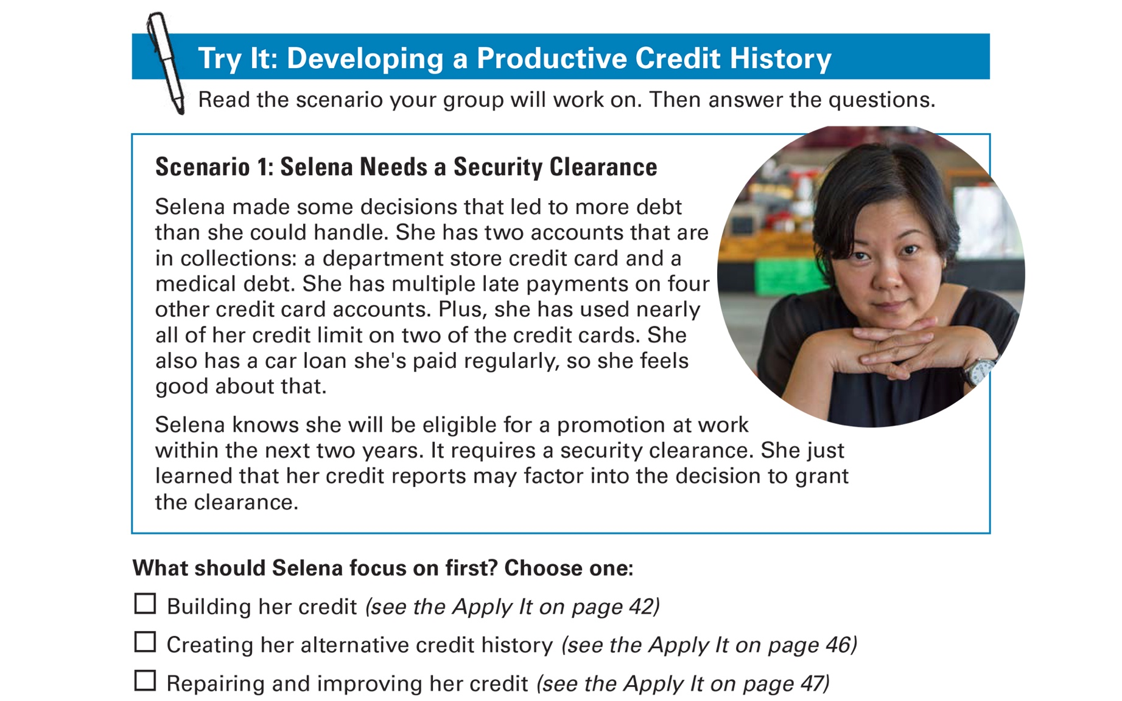
Try It: Developing a Productive Credit History

Slide 37
Build Credit
Get a secured credit card
Get a credit-building loan
Become an authorized user on an account
Get a cosigner
Apply for a credit card at a store or gas station
Make a large down payment and negotiate a loan for the balance

Slide 38
Repair and Improve Credit
Get and review your credit reports
Dispute and correct any errors
Pay all of your bills on time and as agreed
Use as little of your credit limit as possible
Use a credit building strategy
Keep old accounts open if you can
Apply for credit only if you need it
Negotiate different terms
Ask for a “good will” deletion

Slide 39
Build Alternative Credit History
Document other payments you regularly make, such as:
Rent
Childcare
Cell phone bill
Electric bill
Gas bill
Water, sewage, and garbage bills
Television service bill
Internet service bill
Insurance payments
Loan from friend or family member
Savings

Slide 40
Maintain Credit
Pay your bills on time and as agreed
Continue to pay down your debt balances
Keep the proportion of the credit you use low compared with credit limits
Don’t apply for too much credit
Avoid actions or inactions that may create new entries
Pay your taxes and child support in full and on time
Check your credit reports and regularly dispute errors
Keep good financial records

Slide 41
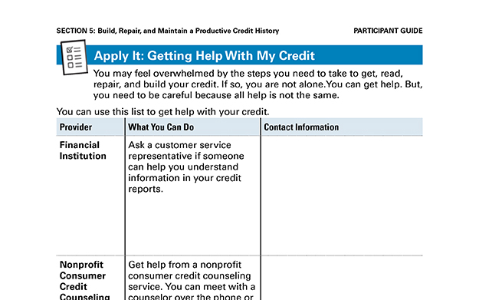
Apply It: Getting Help with My Credit

Slide 42

Get Help
  UF/IFAS Extension in your County
  1:1 Financial Counselors, AFC
Financial institution –who you bank with
Nonprofit consumer credit counseling
service –use caution!
Housing Counseling Agency approved by Department of Housing and Urban Development (HUD)
Certified Financial Planners (CFPs)
Other

Slide 43

Use Caution
Debt consolidation
  Taking out new loan to pay off
  other debts
  Does not address underlying causes of debt
Debt settlement
  Working with creditors to accept lower payment and settle debt
  Might have to pay income tax on portion that was settled

Slide 44
Protecting Your Credit History
Initial fraud alert
Active-duty military alert
Extended fraud alert
Credit freeze
Credit lock

Slide 45

Credit Repair Scams
Beware of credit repair companies that:
Promise to erase bad credit or remove other negative, but accurate, information
Promise fast and easy credit repair
Offer to create a new identity for you
Want you to pay upfront
Will not tell you about your rights

Slide 46
Section 4: Key Takeaway
Your credit history does not have to be your credit future.

Slide 47
Take Action
What will You do?
How will You do it?
Will You share Your plans with others? If so, who?
Visit fdic.gov/education to learn more

