Slide 1
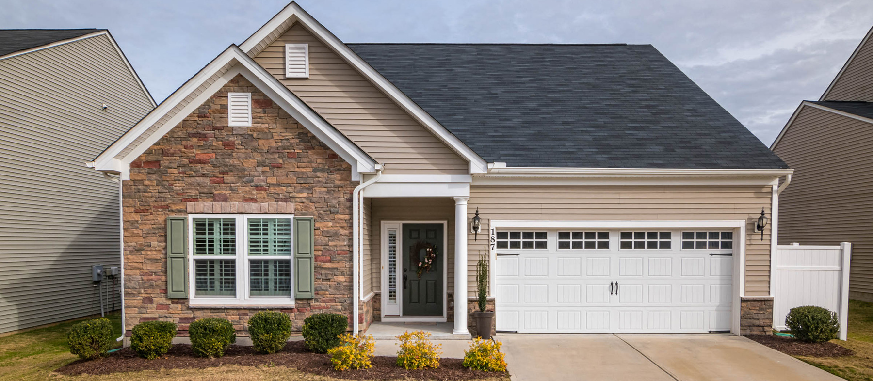
Understanding the Mortgage Process
PRESENTED BY LISA HAMILTON AND LORI RIVERA

Slide 2
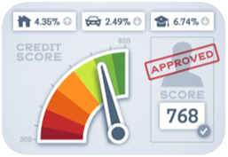
4 C’s of Credit
HOW DOES THE BANK LOOK AT ME?
Capital
Collateral
Capacity
Character

Slide 3
CAPITAL
Lenders consider savings, investments (reserves) and other property you may own that is fairly easy to liquidate
COLLATERAL
The property
CAPACITY
What is their ability to pay the loan?
CHARACTER
THE 4 C'S OF CREDIT
Credit Worthiness/Credit History

Slide 4
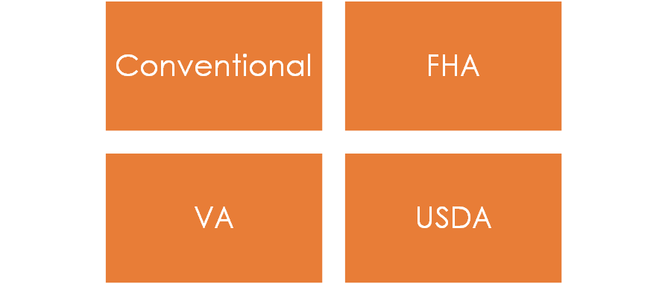
COMMON TYPES OF LOANS
Which is right for me?

Slide 5
FHA
PROS
CONS
580-660+ CREDITSCORE
DEBT TO INCOME UP TO 57%
LENDING LIMIT BASED ON COUNTY & TYPE OF STRUCTURE (SFH, DUPLEX, TRIPLEX, ETC)
MORE PROTECTION FOR INABILITY TO REPAY
MI ENTIRE LIFE OF THE LOAN
MOVE-IN CONDITION
PRIMARY RESIDENCE ONLY

Slide 6
CONVENTIONAL
PROS
CONS
MORTGAGE INSURANCE DROPS OFF AFTER 80% OF ORIGINAL MORTGAGE IS PAID
STRONGER OFFER IN A SELLERS’ MARKET
MAY REQUIRE 6 MONTHS OF RESERVE
MINIMUM CREDIT SCORE 620
PRIMARY RESIDENCE ONLY
LOWER DTI BASED ON HOW MUCH YOU PUT DOWN

Slide 7
VA
PROS
CONS
NO MINIMUM CREDIT
HIGHER DTI
NO MI
MORE PROTECTION FOR INABILITY TO REPAY
USE REPEATEDLY-PRIMARY RESIDENCE ONLY
SERVED IN THE MILITARY OR SURVIVING SPOUSE
50 MILES AWAY FROM THE SECOND RESIDENCE
A COMPLICATED FORMULA THAT CHANGES WITH EACH PURCHASE

Slide 8
USDA
PROS
CONS
UP TO 45% DTI
MINIMUM 620 CREDIT SCORE
MI ENTIRE LIFE OF THE LOAN
MORE PROTECTION FOR INABILITY TO REPAY
LIMITED BY LOCATION

Slide 9
What is included in the monthly payment?
PRINCIPAL
INTEREST
TAXES
INSURANCE
BOTH HAZARD (HOMEOWNERS AND MORTGAGE )
ASSOCIATION FEES

Slide 10
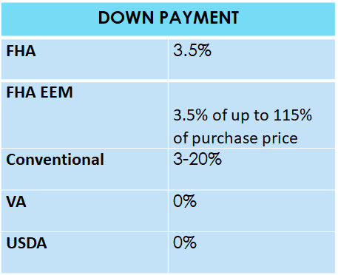
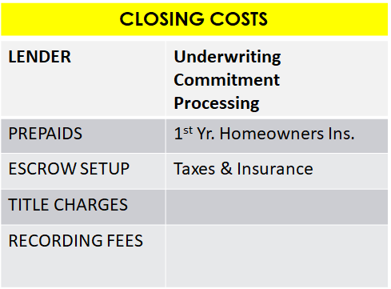
How Much Will I Need?

Slide 11
After you receive your pre-approval and are ready to start shopping:
DO
DON'T
Continue monitoring your credit and paying bills on time
Get requested documents to your lender, realtor, insurance agent, and title company promptly
Continue saving money
Communicate frequently with your team
Open/apply for new lines of credit
Spend your escrow deposit on a vacation
Quit your job
Ignore your team's calls, emails or texts

Slide 13
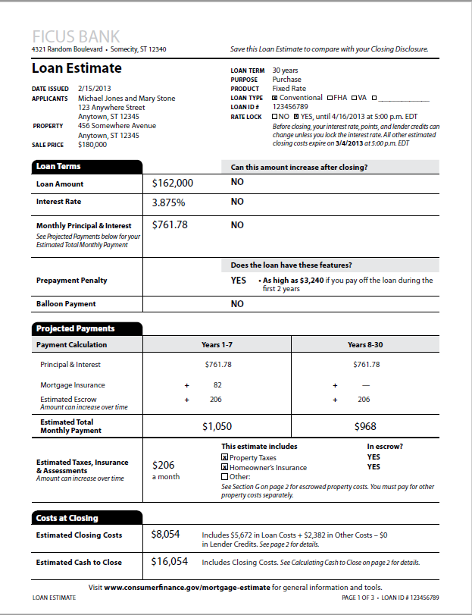

Slide 14
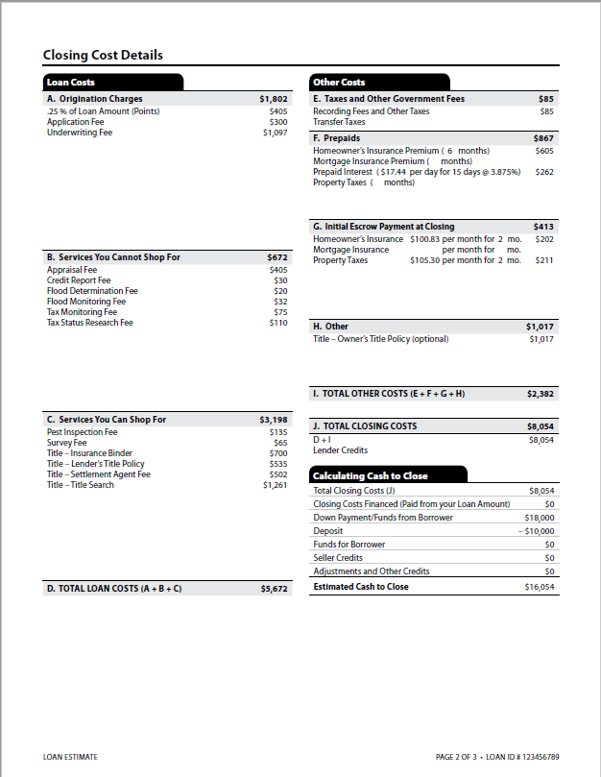

Slide 15
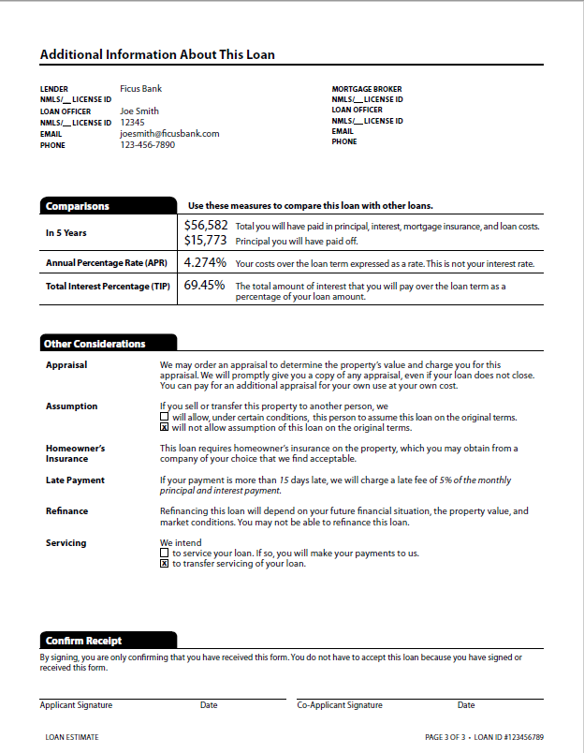

Slide 16
Housing Affordability & FAQ's
Can a third party contribute to my closing costs (sellers' concessions or gift from relative)?
How do student loans affect my ability to obtain a loan?
How much cash do I need to save before I go home shopping?
Whom do I contact if I have a problem with a lender?
Florida Office of Financial Regulation
https://flofr.gov
850-487-9687 or CFPB, FFTC Nationwide

Slide 17
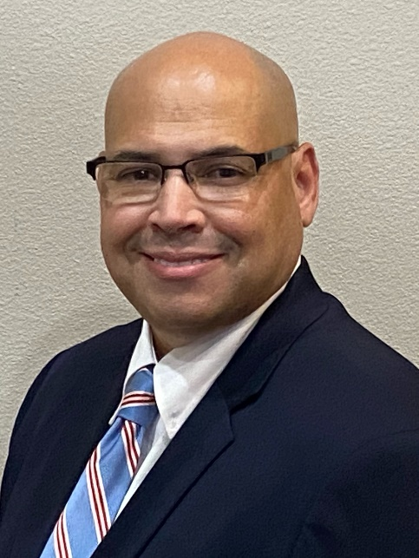
Juan “Omar” Matos
Mortgage Community Loan Officer
Regions Mortgage
NMLS ID 1243666
C: (407) 403-3727
Juan.Matos@regions.com

Slide 18
Thank you!

