Slide 1
Take Control of Your Money: Credit Repair
Shari Bresin
Family and Consumer Sciences Agent, Pasco County
UF/IFAS Extension
An Equal Opportunity Institution

Slide 2
Objectives
Increase understanding of the types of negatives on credit report (debt collections, medical collections, auto repossession, eviction, student loan default, etc.)
Identify strategies to address each type of negative on a credit report

Slide 3
Purpose
By addressing negative accounts on your credit, you can:
Improve your credit report
Increase your credit score
Obtain better offers from lenders
Increase employment opportunities
Possibly better utility bill deposits, car insurance premiums

Slide 4
Activity 1: Financial Wellbeing Survey
https://www.consumerfinance.gov/consumer-tools/financial-well-being/
What is your financial picture like? What actions can you take?

Slide 5
What is a Credit Report?
Easy-to-read summary of your credit accounts and debts
Information compiled by a credit bureau from merchants, utility companies, banks, court records, and creditors about your payment history
The “behind the scenes” information on your score
A report that details your financial behaviors
Do you repay debts as agreed?
Any late payments?
Anything in collections?
Etc.
Creditors provide your history/info to the 3 credit reporting agencies
Public records also provide information

Slide 7
Who sees my credit report?
Creditors/Lenders
Employers
Insurance companies
Landlords
Utility companies
Government agencies (for public assistance eligibility or collecting child support)

Slide 8
Why Check This?
So you can see what lenders, landlords, and companies see
Gives you an idea on terms and interest rates you’ll be offered for big purchases
Gives you a chance to catch errors or spot identity theft

Slide 9
How can you access your credit report?
3 credit bureaus:
Equifax
Experian
TransUnion
Your credit report will not show your score
All 3 reports can be found on annualcreditreport.com
View each bureau’s report 1x/year (so 3 views for the year)
Why look at all 3?
Not every debt/account gets reported to all 3 bureaus
Note: one free view PER WEEK from all 3 bureaus until April 2022

Slide 10
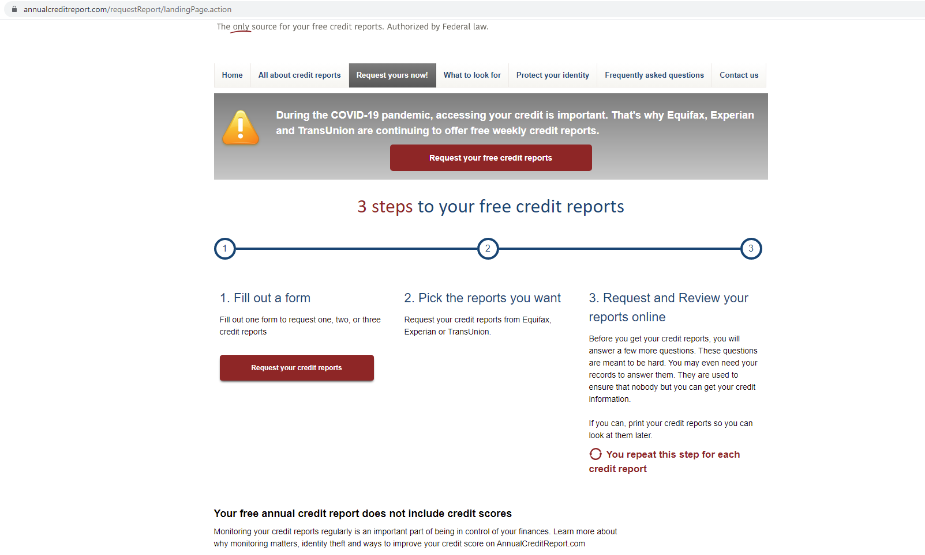

Slide 11
Another way to get your credit report
Turned down for credit in the past 60 days
You requested a fraud alert
Unemployed and applying for a job within the next 60 days
Receiving public assistance
You believe your credit report contains fraud
Contact the bureaus directly if needing a report based on these reasons
Experian.com
Equifax.com
Transunion.com

Slide 12
Assessing Your Report
Age, type of negative, options for resolution and/or removal.
Potential negatives (always check for accuracy)
Give examples
Removed after 7 years

Slide 13
Types of Negative Information (Equifax.com)
Late/missed payments
Delinquency=missing a single payment
Default=Continuous missed payment
Charge-offs
Accounts sent to collections (credit card, medical, student loans, etc.)
Accounts not being paid as agreed
Bankruptcy
Repossessions
Unpaid rent/evictions
Foreclosures
Short sales or deed in lieu of foreclosure
Notes:
https://www.equifax.com/personal/education/covid-19/how-short-sale-foreclosure-affects-credit-scores/
https://www.investopedia.com/ask/answers/062315/what-are-differences-between-delinquency-and-default.asp
From Natasha: (debt collections, medical collections, auto repossession, eviction, student loan default, etc.)

Slide 14
Charge Off’s
A charge-off usually happens after you’ve been delinquent on a debt for 180 days or six months. It is the credit card issuer's way of taking a loss on the debt. In their accounting documents, they’ve written the account off as uncollectible, and they no longer consider the debt as an asset. Creditors can continue collecting on a charge-off until you pay, even though it's been charged off.
Many times, moves on to collections

Slide 15
Charge Off’s
When creditors cancel debts, they are required to report the canceled amount (if it's over $600) to the IRS using Form 1099-C cancellation of debt.²
You'll also receive a copy of the form in the mail, typically around tax time if it applies. You may not have personally encountered this tax situation before, but it's pretty common.
The IRS estimates nearly 4 million 1099-C forms will be sent to taxpayers in 2021

Slide 16
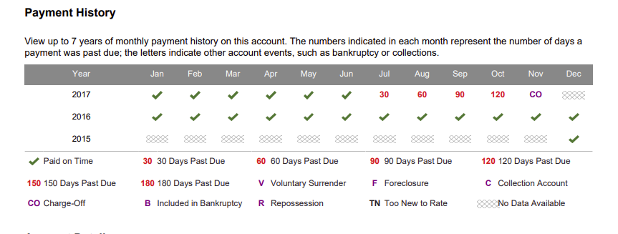

Slide 17
Assessing Your Report: Age
Negative information stays on your credit report for 7 years (and chapter 13 bankruptcy)
Chapter 7 bankruptcy stays on for 10 years
If you brought a delinquent account current, status will change to “paid as agreed” but negative information will still stay on for 7 years
What does this mean for your score?
The fresher the negative account, the more it hurts your score
The more time that goes by, the less it negatively impacts your score
Hard inquiries stay on for 2 years
When a lender requests a copy of your report
Not considered negative, but does impact your score
If shopping for a car or house, multiple hard inquiries in a 45-day period counts as 1 inquiry
What about positive information?
An account in good standing stays on for as long as account is open
An account that is closed and paid as agreed stays on for 10 years.
Notes:
https://www.equifax.com/personal/education/credit/report/how-long-does-information-stay-on-credit-report/
https://www.cnbc.com/select/how-long-negative-information-stays-on-credit-reports/
https://www.experian.com/blogs/ask-experian/when-does-7-year-rule-begin-delinquent-accounts/

Slide 18
Which ones to prioritize ?

Slide 19
Options for Resolution and/or Removal
Don’t ignore debts or debt collectors
If they sue you and the judge rules that you owe, they can garnish your wages or freeze your bank account
Look over your budget to discuss a payment plan before calling lenders/debt collectors
Can you afford the lump sum?
Will they offer a payment plan?
What monthly payments can you realistically make?
What about settlement?
Note: settlement still a negative because not paying as agreed, but not as bad for credit score as delinquency/default
Get any agreement in writing and do not give a debt collector electronic access to your bank account
Notes:
https://www.experian.com/blogs/ask-experian/will-settling-a-debt-affect-my-score/

Slide 20
What if you catch an error?
Send a written dispute letter to the credit bureau
They are legally required to investigate the matter and make necessary corrections
Credit bureau will double check with the lender on your behalf, where they will verify it, make updates, or delete it
About 30-day process
If lender says it’s correct, contact them directly to discuss discrepancy
Can also send a statement letter to credit bureau to explain inaccuracy to be included on credit report (free)

Slide 21
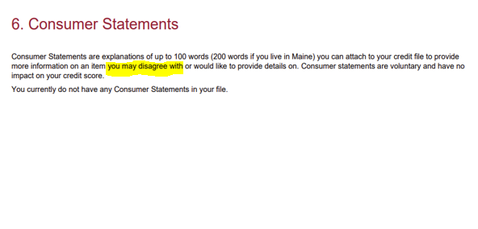

Slide 22
Statute of Limitations (debt.org; incharge.org)
Different from the 7-year rule on credit reports
Point when a debt can no longer be successfully sued
May try to scare you and sue anyway
Repaying it or signing a payment agreement restarts the time period
Depends on debt
4 years: revolving debts
5 years: written contracts such as personal loans
Moved? Check with a consumer lawyer
Notes:
https://www.debt.org/faqs/americans-in-debt/consumer-florida/
https://blog.vanhornlawgroup.com/florida-statute-of-limitations-on-debt-collection/
https://www.incharge.org/understanding-debt/credit-card/what-is-statute-of-limitations-all-50-states/

Slide 23
Collections
Stays on report for 7 years
Will be updated to “paid” with a zero balance in 1-2 months
Collection agency should notify the credit bureaus
If not, contact the bureaus and have proof of payment ready
Settlement may have tax implications
Notes:
https://www.experian.com/blogs/ask-experian/how-do-i-get-a-paid-collection-off-my-credit-report/

Slide 24
Addressing Charge-Offs
Actions similar to collections
Settlement may have tax implications
From “charge-off” to “paid charge-off” and stays for 7 years
Doesn’t restart if sold to collections
Still considered negative but not as negative as an unpaid charge-off
Notes:
https://www.experian.com/blogs/ask-experian/what-is-a-charge-off/

Slide 25
Addressing Federal Student Loans
9 months of missed payments = default
Not eligible for special repayment plans or deferment options
Getting out of default:
Pay off loan balance
Loan consolidation
Take out a new loan to pay off current one(s) in default; new = not in default
Note: do not consolidate federal student loans into private loans
Credit report will say paid in full but still notes the default status
Loan rehabilitation
Make 9 payments for 10 consecutive months to get out of default
Missing one payment starts it all over again
Default gets erased from your credit report
Notes:
From Surviving Debt book pg 121 and 122

Slide 26
Addressing Private Student Loans
Can’t garnish your wages or tax returns like with federal student loans
Less collection options = higher chance to negotiate lower payment
Get any new terms in writing, and make sure it isn’t over statute of limitations (date of last activity on account…payment, agreement, verbal promise to pay, etc.)

Slide 27
Addressing Medical Debt
Don’t pay medical debt off with a credit card
Don’t take medical credit card
Medical debt will not appear on credit report for 6 months
But gets sold to debt collectors before or after 6 months
Work on repayment plan with debt collector
Only pay if you can afford other high priority debts and bills
Notes:
Pg. 99

Slide 28
Addressing Evictions
Stays on for 7 years
Pay off your past-due balance
Ask landlord to update status as “paid”
Negatives still there, but “paid” looks better
Notes:
https://wallethub.com/answers/cs/how-do-i-get-an-eviction-off-my-credit-report-2140646831/
https://bettercreditblog.org/remove-repossession-credit-report/

Slide 29
Repossession
Can you pay off balance in full?
If so, offer this if they promise to remove from credit report
Check for inaccuracies on dates, balance, terms, account numbers, etc.
Can dispute anything wrong to the credit bureau and they may remove it if they verify the inaccuracies (part of FCRA)

Slide 30
Laws To Protect Us (Federal Trade Commission.gov)
Law | Purpose
Equal Credit Opportunity Act | Prohibits discrimination in lending on the basis of race, color, religion, national origin, sex, marital status, age, or receipt of public assistance. If rejected, creditor must provide reason within 60 days and give you a free credit report
Fair Credit Reporting Act | Protects information collected by reporting agencies such as credit bureaus, medical information companies and tenant screening services. Information in a consumer report cannot be provided to anyone who does not have a purpose specified in the Act, and must investigate disputed information within 30 days; negative info is removed after 7 years; allows access on annualcreditreport.com
Fair Debt Collection Practices Act | To eliminate abusive debt collection practices by debt collectors (can only call at certain times, can’t threaten or lie, must stop contacting if you write a cease letter, etc.); only applies to third party collectors
Truth in Lending Act | Requires written disclosures concerning finance charges and related aspects of credit transactions (including disclosing APR) are included, and requires advertisements to include certain disclosures.
Credit Repair Organizations Act | Prohibits untrue or misleading representations and requires certain affirmative disclosures in the offering or sale of "credit repair" services. The Act bars companies offering credit repair services from demanding advance payment, requires that credit repair contracts be in writing, and gives consumers certain contract cancellation rights.
Notes:
https://www.ftc.gov/enforcement/statutes/equal-credit-opportunity-act

Slide 31
Resolve Negatives: Use CFPB Letters
Consumer Financial Protection Bureau
www.CFPB.gov
https://www.consumerfinance.gov/consumer-tools/credit-reports-and-scores/sample-letters-dispute-credit-report-information/

Slide 32
Sample of Experian Credit Report
https://stcroix.extension.wisc.edu/files/2012/10/2012-Fall-sample-credit-report.pdf

Slide 33
Case Studies
Your examples
Any questions?

Slide 34
THANK YOU! ☺

