Slide 1
Budget, Savings, and Credit
Shari Bresin
Family and Consumer Sciences Agent
University of Florida/IFAS Extension
An Equal Opportunity Institution

Slide 2
Objectives
Participants will learn about the signs of too much debt and financial stress
Participants will list out their debts on the debt worksheet
Participants will learn how to calculate the debt-to-income ratio
Participants will be introduced to PowerPay.org to learn how to work a debt snowball into their budget
Participants will enter their income and expenses on budgeting calendar
Participants will learn what comprises a credit score

Slide 3
Your relationship with money…
5 different money values (Pulvino and Pulvino, 2010)
Which one are you? Which do you agree with the most?
Power: Money should be used to control others
Status: Money allows me to drive a certain type of car
Love: I want to use my financial resources to help the needy
Security: The greatest value of money is that I don’t have to worry about the future
Autonomy: Money allows me to do the things I want

Slide 4
Ice Breaker: Money memories
Earliest memory of money?
Most positive memory?
Most negative?

Slide 5
Scenario
You get in the car to go to work but it won’t start. You call a towing service to bring it to your mechanic, who tells you the cost to fix it is $400.
You:
A) Pay the $400 in cash/check/debit card from your emergency fund
B) It’s going on the credit card and will be paid in full (plus get rewards points)
C) It’s going on the credit card and will need take a few months to pay off. In the end it will cost more than $400 thanks to credit card interest
If “C” sounds more like you, then that’s a sign you are not budgeting/saving.

Slide 6
The Stats
Total US consumer debt: $13.86 trillion
Average credit card holder has at least four different cards
Average credit card debt for Florida:
$8,444 (12-highest in US)
78% of US workers live paycheck to paycheck (Forbes.com)
40% of Americans don’t have $400 readily available in cash to get them through an emergency

Slide 7
Signs of money mismanagement (Garman and Forgue, 2018)
Not knowing how much you owe (lost track or avoid knowing)
Using credit cards when you run out of cash
Paying only the minimum amount due
Exceeding debt limits and credit limits
Requesting new credit cards and increases in credit limits
Using cash advances to pay other credit cards
Paying late or skipping credit payments/receiving late notices
Refinancing
Using debt-consolidation loans
Having wages garnished

Slide 8
Signs of financial stress (Center for Financial Social Work)
Can’t make monthly minimum credit card payments
Having more days in the month than money for the month
Owing more on your car than it is worth
Unable to make rent or mortgage payment
Moving more than once a year to reduce rent
Canceling a service because you can’t afford it
Regularly withdrawing money from ATMs
Not participating in an activity you enjoy because you can’t afford it
Considering bankruptcy
Using a check-cashing store
Screening incoming calls to avoid creditors
Taking payday loans

Slide 9
Signs of money mismanagement (Center for Financial Social Work)
Can’t make monthly minimum credit card payments
Having more days in the month than money for the month
Owing more on your car than it is worth
Unable to make rent or mortgage payment
Moving more than once a year to reduce rent
Canceling a service because you can’t afford it
Regularly withdrawing money from ATMs
Not participating in an activity you enjoy because you can’t afford it
Considering bankruptcy
Using a check-cashing store
Screening incoming calls to avoid creditors
Taking payday loans

Slide 10
Use of credit (Garman and Forgue, 2018)
Advantages
Disadvantages
Convenient
Enjoy things now instead of waiting to save up (including car and house)
Reduce need to carry cash
To shop online or phone
To show ID
To enjoy grace period of 21 days on new credit card purchases
To pay for emergencies
For education
To make travel reservations
Rewards
To pay for several purchases in one payment
To easily return merchandise
To protect against seller rip-offs and frauds
Temptation to spend more money than you actually have
Reduces your future purchasing power
Future income is committed to previous credit contracts
Slows progress to achieving financial goals
Risk of overindebtedness
Interest and fees
Increased chance of identity theft
Stress
Possible property loss (repossession)
May need to declare bankruptcy
Could cause harm to credit history and credit score

Slide 11
Why budget?
Reach your financial goals
Increase cash surplus/ build your emergency fund
Save money on interest
Less money stress
INCREASE YOUR CREDIT SCORE

Slide 12
Budget experience
What has been your experience with budgeting?
What challenges did you face?
How did you make it routine?

Slide 13
Budgeting tools
UF Extension Money Management Calendar (fillable or print)
Mint
EveryDollar
YNAB (free for students)
PocketGuard
Clarity Money
Old fashioned Excel spreadsheet

Slide 14
Budget and Housing
Pre housing:
Get finances in order (clear up debts/lower debt ratios)
Have an emergency fund
Save for a down payment

Slide 15
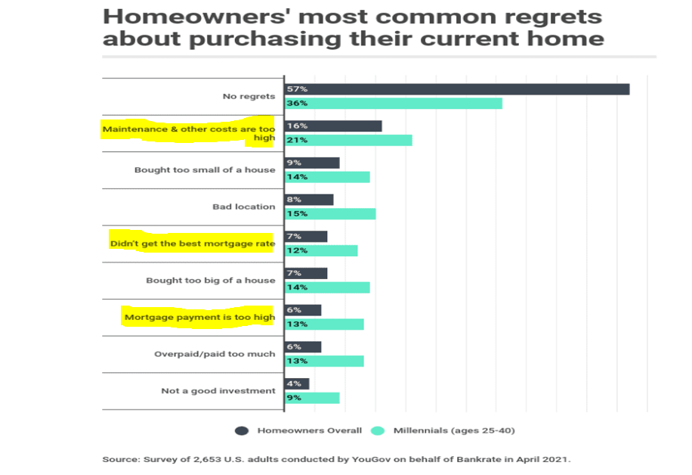

Slide 16
Debt-to-income ratio (aka back-end ratio)
How much of your income is going towards debt?
How much you owe each month (including mortgage) $÷$ monthly gross income
How much you owe each month (including mortgage) ÷ monthly gross income
Should not exceed 36%
Lenders look at this
The lower your debt-to-income ratio, the better chances of obtaining a mortgage
Example:
John and Cara have a combined household income of $6000 gross. Their total consumer debts is $2500, including their mortgage. What is their debt-to-income ratio?
42%
Is that too high?

Slide 17
Debt -to-Disposable Income Ratio
Tells you if your consumer (nonmortgage) debt is too stressful
Monthly debt payments $÷$ monthly disposable income
Does not count mortgage or monthly credit card balances paid in full
Disposable income=income left after taxes, insurance, retirement withholdings, etc.
Should be 14% or less
Example: monthly disposable income of $3000, debt payments are $1500/month
50% ratio!! Debt overly excessive and likely causing money stress
Make $6000, still too high (25%)

Slide 18
Debt Worksheet
Enter your debts: balances, monthly payments, APR, etc.
See chatbox

Slide 19
Emergency Fund
Should be 3-6 months of expenses
Let's you manage all bills during times of job loss
Example: Costs $4000 a month to run your household, how much should be in your emergency fund?
$12,000-$24,000
This needs to be a budget category

Slide 20
Liquidity Ratio
Liquid assets / monthly expenses
Liquid assets=cash, checking account, savings account, CDs, money market account, money owed to you
Measures how capable you are of paying bills on time during a job loss
Emergency fund: 3-6 months of expenses
Example:
Someone has $10,000 in a savings account, and their monthly expenses are $6000
10,000/6,000= 1.6
This person can only handle around one and half months of bills
Need to increase savings account/liquid assets, less expenses/debt, or both

Slide 21
What can you do?
Paying off debt frees up your budget, improves ratios
$300 towards your car now becomes $300 to save
How do you pay off debt?
Make a plan—can an $8000 credit card be paid off in 3 years? 2 years?
Make sure debts are part of your budget
Make Power Payments: taking the payment amount of a debt that has been paid off and applying that amount to another debt

Slide 22
Power Pay: taking the payment amount of a debt that has been paid off and applying that amount to another debt
First, find out exactly how much you owe!
Write out your non-mortgage debts (car, student loan, medical, credit cards, personal loans, etc.)
Then enter it into PowerPay.org

Slide 23
Where to get extra money to make “power payments” ?
Fixed vs flexible expenses
What tweaks can you make on your flexible expenses?
Start meal planning and couponing to save on groceries, purchase clothes at thrift stores
What omissions can you make?
Lunches out during work week, coffee to-go, etc.
Side job for extra income

Slide 24
Fixed vs Flexible: Finding Where to Pinch Pennies
Fixed Expenses
Flexible Expenses
Expenses with amounts that don’t change from month to month
Examples:
Mortgage/rent
Car payments
Day care
Phone plan
Utility bills
Student loans
Insurance
Expenses with amounts that may change from month to month; have most control over costs (ie: groceries, presents); some months may not have certain categories (ie: clothes)
Examples
Dining out
Groceries
Hobbies
Gifts
Clothing
Entertainment

Slide 25
Your budget: crunching numbers
If you’re running a surplus each month, you can apply it towards the debt
Running a deficit or living paycheck-to-paycheck? Need to look over your budget
Debts need to be part of your budget, like mortgage, groceries, etc.
Let’s look at the Money Management Calendar (see chat box)

Slide 26
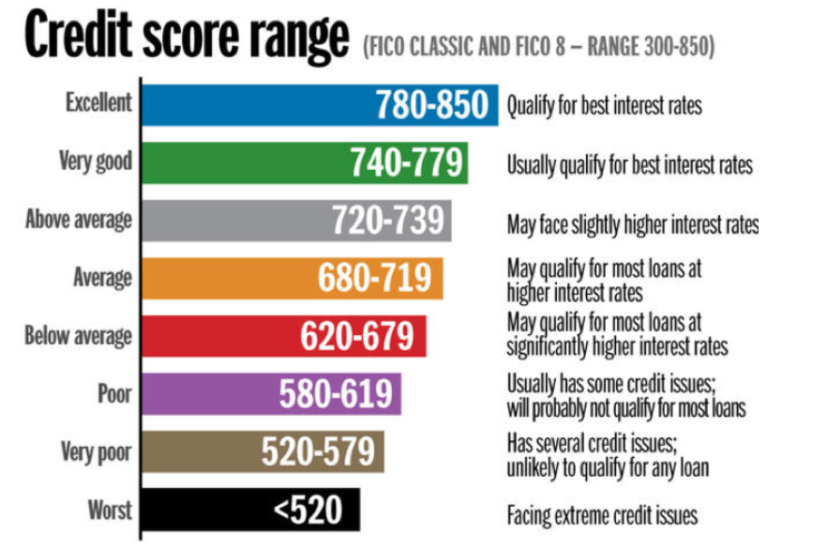
Source: South Wesleyan University

Slide 27
Five Factors of your Credit Score
Mortgage lenders look at this, in addition to debt-to-income ratio
Better credit score=better interest rate

Slide 28
Credit report
Credit score and credit report are two different things
Important to check your credit report throughout the year
Catch errors or identity theft
Learn about debts you may not be aware of
Annualcreditreport.com
Experian
Equifax
TransUnion
CreditKarma.com uses Vantage score, not FICO

Slide 29
Building/Improving Credit Score
Make consistent on-time payments (payment history = 35% of credit score algorithm)
Both for lines of credit and utility bills
Use credit cards from retail businesses
Note: you must have the discipline to pay off balance each month
Secured credit card
Collateral through the cash deposit you arrange through the account
If you don’t pay your bill, the card issuer simply takes the deposited money
Limit based on the cash you deposit…$500 deposit is a $500 limit, don’t pay the bill, they take the money….lowers risk for card issuer
Upgrade to a regular (unsecured) credit card once you increase your credit score (may take a year)
Pick one that transfers to unsecured credit card to avoid opening a new account (credit inquiries=10% of credit score algorithm)

Slide 30
Feeling overwhelmed? What to prioritize…
Creditor successfully sued you over a debt
Car loans/leases
Housing
Utility bills
Child support debts
Real estate taxes
Federal student loans
Taxes owed to IRS

Slide 31
Survey on Qualtrics
https://ufl.qualtrics.com/jfe/form/SV_0IFH5laEBPqv8GO
Notes:
As a result of this presentation, I learned
The benefits of being debt-free
Signs of being in too much debt
Signs of financial stress
How to use PowerPay.org

Slide 32
Thank you Remember: Financial freedom is not based on how much you make. It’s based on how much you spend
Any questions?

Slide 33
Thank you Remember: Financial freedom is not based on how much you make. It’s based on how much you spend
Any questions?
Need free, private one-on-one financial counseling? See link, or email me to learn more
Register here: https://ufl.qualtrics.com/jfe/form/SV_6gtB5ixt5oIYDrv
Email me for resources, peer-reviewed literature, or information about upcoming classes: sbresin@ufl.edu

